Slide 1
Instrument Transformer
Electrical Measuring Instruments & Instrumentation
4TH SEMESTER ELECTRICAL ENGG.
Barjinder singh
Senior Lecturer Electrical Engg.
Government Polytechnic College,
Guru Teg Bahadurgarh, Moga
18/03/2013

Slide 2
Topics
Introduction
Uses of instrument transformer
Advantages
Current transformer
Shell type current transformer
Ring type current transformer
Burden of an instrument transformer
Phase diagram
18/03/2013

Slide 3
Topics
Errors in instrument transformer
Phase angle error
Methods to minimize errors
Type of current transformer
Potential transformer
Construction of potential transformer
Difference between CT and PT
Errors in potential transformer
Methods to minimize errors
Examples
18/03/2013

Slide 4
Introduction
These are special type of transformers used for the measurement of voltage, current, power and energy. As the name suggests, these transformers are used in conjunction with the relevant instruments such as ammeters, voltmeters, watt meters and energy meters.
18/03/2013

Slide 5
Types of Instrument Transformer
Such transformers are of two types :
Current Transformer (or Series Transformer)
Potential Transformer (or Parallel Transformer)
Current transformers are used when the magnitude of AC currents exceeds the safe value of current of measuring instruments.
Potential transformers are used where the voltage of an AC circuit exceeds 750 V as it is not possible to provide adequate insulation on measuring instruments for voltage more than this.
18/03/2013

Slide 6
Uses of Instrument Transformer
It is used for the following two as:
To insulate the high voltage circuit from the measuring circuit in order to protect the measuring instruments from burning
To make it possible to measure the high voltage with low range voltmeter and high current with low range ammeter.
These instrument transformers are also used in controlling and protecting circuits, to operate relays, circuit breakers etc. The working of these transformers are similar as that of ordinary transformers.
18/03/2013

Slide 7
Use of Instrument Transformer
Measurement of current as CT
The primary winding is so connected that the current to be measured passes through it and the secondary is connected to the ammeter .
The function of CT is to step down the current.
18/03/2013

Slide 8
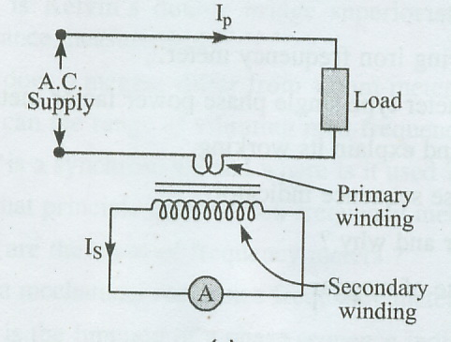
Instrument Transformer as CT
18/03/2013

Slide 9
Use of Instrument Transformer
Measurement of voltage by PT
The primary winding is connected to the voltage side to be measured and secondary to the voltmeter.
The function of PT is to steps down the voltage to the level of voltmeter.
18/03/2013

Slide 10
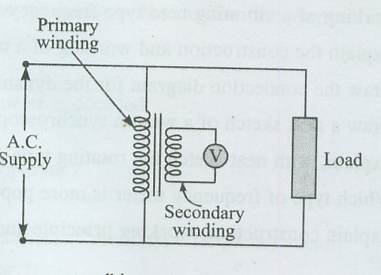
Instrument Transformer as PT
18/03/2013

Slide 11
Advantages of Instrument Transformer
The measuring instruments can be placed for away from the high voltage side by connecting long wires to the instrument transformer. This ensures the safety of instruments as well as the operator.
This instrument transformers can be used to extend the range of measuring instruments like ammeters and voltmeters.
18/03/2013

Slide 12
Advantages of Instrument Transformer
The power loss in instrument transformers is very small as compared to power loss due to the resistance of shunts and multipliers.
By using current transformer with tong tester, the current in a heavy current circuit can be measured.
18/03/2013

Slide 13
Disadvantages of Instrument Transformer
1. The only main draw back is that these instruments can not be used in DC circuits.
18/03/2013

Slide 14
Current Transformers
In order to minimise the exciting ampere turns required, the core must have a low reluctance and small iron losses.
The following three types of core constructions are generally employed :
Core type
Shell type
Ring type
18/03/2013

Slide 15
Core type
It is rectangular form core type. The laminations are of L shaped assembled together.
The winding are placed on one of the shorter limbs, with the primary usually wound over the secondary. The main advantage of this type of core is that sufficient space is available for insulation and is suitable for high voltage work.
18/03/2013

Slide 16
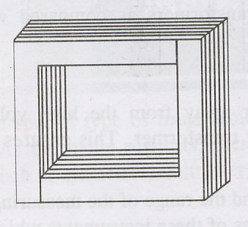
Core type
18/03/2013

Slide 17
Shell type
In shell type, the windings are placed at the central limb, thus it gives better protection to the windings.
18/03/2013

Slide 18
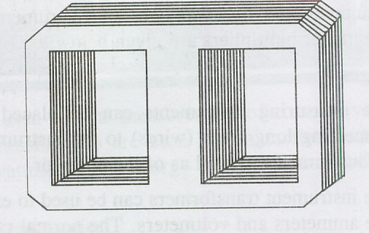
Shell type
18/03/2013

Slide 19
Ring type
Ring type core is commonly used when primary current is large. The secondary winding is distributed round the ring and the primary winding is a single bar.
It is a joint less core and there is very small leakage reactance.
18/03/2013

Slide 20
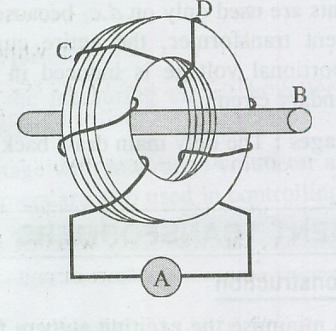
Ring type
18/03/2013

Slide 21
Current Transformer ( CT )
A current transformer is an instrument transformer which is used to measure alternating current of large magnitude by stepping down by transformer action. The primary winding of CT is connected in series with the line in which current is to be measured and the secondary is connected to the ammeter.
18/03/2013

Slide 22
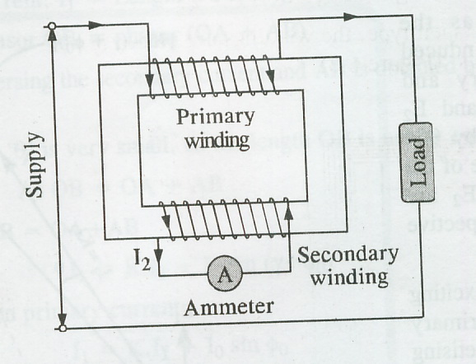
Current Transformer ( CT )
18/03/2013

Slide 23
Current Transformer ( CT )
The secondary winding has very small load impedance which is the current coil of ammeter. The primary side has a few number of turns and the secondary side has large number of turns. The primary winding carries a full load current and this current is stepped down to a suitable value which is within the range of ammeter.
18/03/2013

Slide 24
Burden of Instrument Transformer
The operation of current transformer differs slightly from the power transformer. In case of current transformer, the secondary winding has a very small impedance or “Burden” , so the current transformer operates on short circuit conditions.
The rated burden of this Instrument Transformer is the volt- ampere loading which is permissible without errors exceeding the limits.
18/03/2013

Slide 25
Burden of Instrument Transformer
Burden across the secondary of an instrument transformer is also defined as the ratio of secondary voltage to secondary current.
Z_{L} = secondary voltage/ secondary current
= V / I
The units of burden are ohms.
18/03/2013

Slide 26
Phasor Diagram
Taking flux φ_{m} as the reference vector, the induced e.m.f. in the primary and secondary sides are E₁ and E₂ lagging behind the flux by 90º are drawn. The magnitudes of e.m.f. are proportional to their respective number of turns.
The no load current I_{o} drawn by the primary has two components, magnetising component I_{m} and the working component I_{w .}
18/03/2013

Slide 27
Phasor Diagram
The secondary current I₂ lags behind the voltage by an angle of у .
The angle α is the angle produced by burden connected on the secondary side.
The secondary current I₂ is now transferred to the primary by reversing I₂ and multiplied by K where K is the turn ratio.
18/03/2013

Slide 28
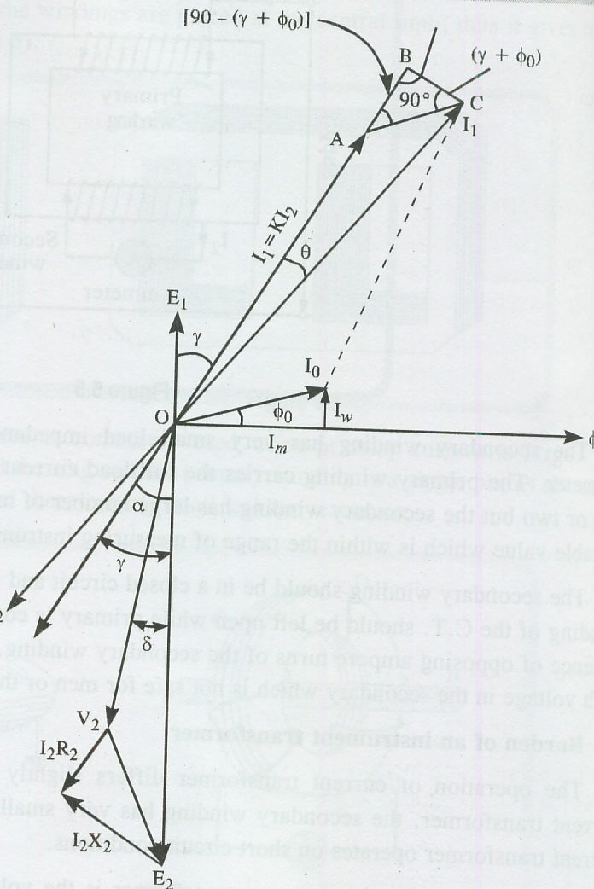
Phasor Diagram
18/03/2013

Slide 29
Errors in Instrument Transformers
There are two types of errors in these transformers :
1. Ratio error
2. Phase angle error
18/03/2013

Slide 30
Ratio Error
For normal operation of these instrument transformers, the current transformation ratio should be constant and within the limits. It has been seen that this ratio are not constant but do vary with the power factor. So this error is known as Ratio Error.
18/03/2013

Slide 31
Ratio Error
The ratio of working component of exciting current to the secondary current of the instrument transformer is called its ratio error. The ratio between actual ratio of current transformation and the normal ratio is known as Ratio Correction Factor,
R.C.F. = Actual Ratio/ Normal Ratio
= K/ K_{N}
18/03/2013

Slide 32
Phase Angle Error
The phase angle error is due to the no load current or exciting current. This is the angle by which the secondary current, when reversed, differs in phase from the primary current
In case of CT, current ratio is more important, while phase angle error is of little importance so long it is connected with an ammeter.
18/03/2013

Slide 33
Methods to minimise Errors
As we know the ratio error mainly depends upon the working component of current and phase angle error depends upon the magnetising component of the current.
To minimise these errors, the following methods should be employed :
18/03/2013

Slide 34
Methods to minimise Errors
In order to minimise these errors, the working and magnetising components (I_{w} and I_{m} ) must be kept at low value. This is possible only by using the material of the core of high permeability, short magnetic path and large cross section area of the core.
The material may be of the following types :
Hot rolled silicon
Cold rolled grain oriented silicon steel
Nickel iron alloys
18/03/2013

Slide 35
Methods to minimise Errors
High permeability nickel iron cores are used for precision current transformers. It has mumtel ( 75 % Nickel, 17 % Fe), hipemik (50 % Fe, 50 % Nickel) are used. These materials have high permeability at low flux densities, therefore these materials are commonly used.
The construction of core has minimum number of joints. Therefore to avoid the joints in building of core, the cores are made if two types,
Ring type core
Spiral type core
18/03/2013

Slide 36
Methods to minimise Errors
2. By providing a suitable turn ratio i.e. number of turns of the secondary can be reduced by one or two turns.
Leakage reactance also increases the ratio error. Therefore the two windings should be closed to each other to reduce the secondary winding leakage reactance.
If the current on the secondary is too large, it should be reduced by putting a shunt either of side. It also reduces phase angle error.
18/03/2013

Slide 37
Types of Current Transformers
As far as the construction of CT is concerned, these are of following types :
1. Bar type CT
This type of CT is placed on the panel board to measure the current of bus bars. The bus bar whose current is to be measured is made to pass through CT. It is of circular or ring type, on which secondary winding is placed. The ammeter is connected in the secondary windings.
18/03/2013

Slide 38
Types of Current Transformers
2. Clamp on / Tong tester
This type of CT can be used with a single conductor. The core of the CT can be split with the help of a trigger switch and therefore, the core can be clamped around a live conductor to measure the current. The single conductor acts as a primary and the secondary is wound on the core of CT. The ammeter is connected in the secondary. This is a portable instrument and generally used in laboratories.
18/03/2013

Slide 39
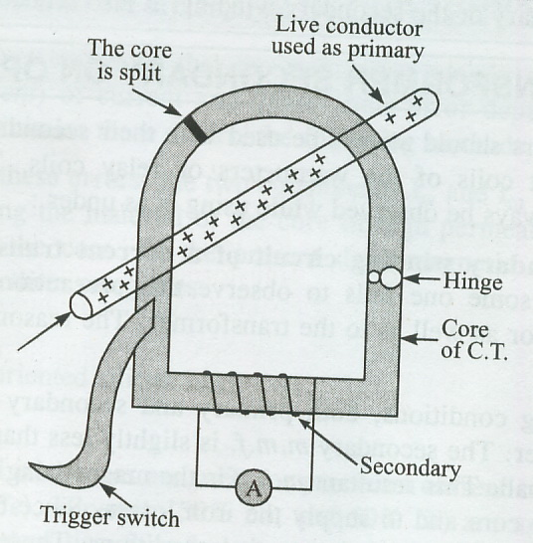
Clamp on / Tong tester
18/03/2013

Slide 40
Application of Current Transformer
The following are the applications ;
Current transformers are used in panel board of sub station or grid station to measure the bus bar current which is very high.
Current transformers are widely used in power measuring circuits. The current coil of the wattmeter is connected with CT.
Current transformers are also used in power houses, sub stations etc. in conjunction with the relays.
18/03/2013

Slide 41
Potential Transformer (P.T.)
These are used to measure alternating high voltage by means of low range voltmeters or for energising the potential coils of wattmeter and energy meters. These types of transformers are also used in relays and protection schemes.
The high voltage which is to be measured is fed to the primary of PT, which is stepped down and is measured by a low range voltmeter on the secondary. The turns of primary side are more than secondary side. The turn ratio of transformer is so designed which keep secondary voltage 110 V when full rated voltage is applied to the primary side.
The principle of operation of potential transformer is same as that of power transformer.
18/03/2013

Slide 42
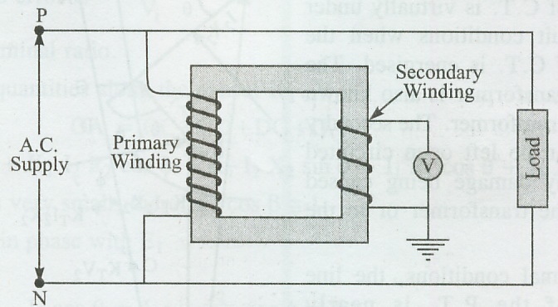
Potential Transformer (P.T.)
18/03/2013

Slide 43
Construction Potential Transformer
Basically a Potential transformer (PT) is a two winding transformer. The primary is connected with high voltage and has more number of turns and the secondary which has less number of turns, steps down the voltage between 110 V to 120 V. The core of the transformer is a shell type. The low voltage winding (secondary) is wound first around the core of the transformer to reduce the size of PT.
18/03/2013

Slide 44
Construction Potential Transformer
The insulation is placed in between the L.V. winding and H.V. winding and finally high voltage winding is placed around the core. The P.T.’s which are used up to 6.6. KV are of DRY type and the other of higher ratings are generally oil immersed type.
18/03/2013

Slide 45
Construction Potential Transformer
The few important points are kept in mind :
The output of PT’s is very small and the size of PT is comparatively large, so there is no problem of temperature.
The size of the core of the PT is larger as compared to power transformers.
The material of core should be of high permeability to reduce the iron losses or to reduce the ratio error and phase angle error.
18/03/2013

Slide 46
Construction Potential Transformer
The few important points are kept in mind :
The primary and secondary windings are co axial to reduce the leakage reactance.
There is no danger, if the secondary side of PT is left open circuited.
Usually, cotton tape and varnished are used as insulation. Hard fiber Separators” are also used in between the coils.
18/03/2013

Slide 47
Difference between CT and PT
The few important points regarding the difference in the working of current transformer and potential transformer are given below :
18/03/2013

Slide 48
Difference between CT and PT
1. The current transformer is also known as series transformer. The secondary of CT is virtually under short circuit conditions when the primary of CT is energised.
The potential transformer is also known as parallel transformer. The secondary of PT can be left open circuited without any damage being caused either to the transformer or to the operator.
18/03/2013

Slide 49
Difference between CT and PT
2. Under normal conditions, the line voltage of the PT is nearly constant. The flux density and the exciting current of a PT varies between small range whereas the primary current and excitation of a CT varies over a wide range under normal working conditions.
18/03/2013

Slide 50
Difference between CT and PT
3. The current in the primary of CT is independent of secondary winding conditions whereas current in the primary of PT depends upon the secondary circuit burden.
18/03/2013

Slide 51
Difference between CT and PT
4. The primary winding of the PT is connected across full line voltage, whereas the CT is connected in series with one of the lines and therefore a small voltage exists across its terminals. However the current transformer carries full line current.
18/03/2013

Slide 52
Phase Diagram of PT
In the phase diagram, E₂ is the induced e.m.f. in the secondary and V₂ is the secondary terminal voltage.
V₂ = E₂ – I₂ R₂ cos φ₂ - I₂ X₂ sin φ₂
The primary induced e.m.f. , E₁ is in phase opposite to the secondary induced e.m.f. E_{2.}
18/03/2013

Slide 53
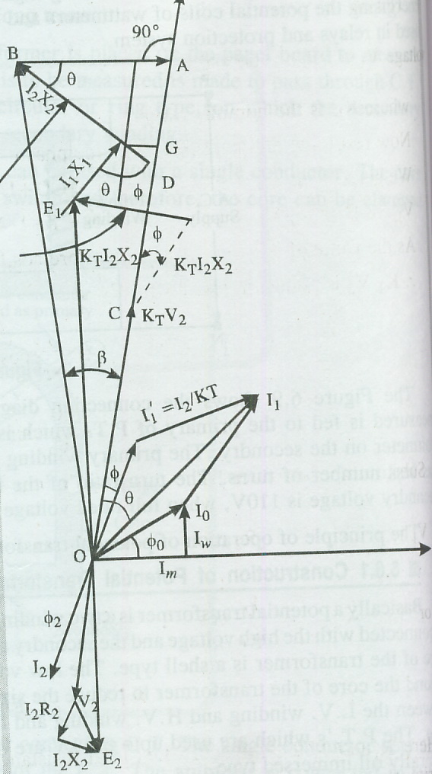
Phase Diagram of PT
18/03/2013

Slide 54
Method to minimise errors in PT
It is seen from the ratio error that the difference between actual ratio and turn ratio is due to the secondary current I₂ and the no load components I_{w} and I_{m.} To minimise these errors the following methods should be adopted :
1. In order to minimise the errors the no load current components I_{w} and I_{m} must be kept very low. This reduction is possible only when the core of transformer is made of good quality material, short magnetic path and low flux density in the core.
18/03/2013

Slide 55
Method to minimise errors in PT
2. By reducing the winding resistance and leakage reactance , these losses are reduced. The resistance can be reduced by providing the winding of thick conductors and by adopting the smallest length of mean turn.
3. By providing a suitable turn ratio i.e. the turn ratio should be less than normal ratio. This is done by reducing the number of turns of the primary or by increasing the number of turns of secondary. This make actual ratio equal to normal ratio.
18/03/2013

Slide 56
Problem 1. A current transformer has a single turn primary and a 200 turns secondary winding. The secondary current of 5 A is passing through a secondary burden of 1 Ohm resistance. The required flux is set up in the core by e.m.f. of 80 A. The frequency is 50 C/S and net cross section area of core is 1000 mm² . Calculate the ratio and phase angle of the transformer. Also find the flux density in the core.
18/03/2013

Slide 57
Solution :
No. of turns on the primary , N₁ = 1
No. of turns on secondary, N₂ = 2000
Impedance on secondary circuit,Z₂ = 1 ohm now turn ratio , K = 200/1 = 200 voltage induced in secondary, E₂ = I₂ .Z₂ = 5 V also , I₁ = K. I₂ the working component of no load current is neglected, I_{w} = 0 now , magnetizing component of no load current = m.m.f./ primary turns so I_{m} = 80/1 = 80 A
18/03/2013

Slide 58
Secondary wing current, I₂ = 5 A
The secondary reverse current , I₁ ‘ = K. I₂ = 200X 5
= 1000 A
Now primary current, I₁ = ( (I_{m} )² + (I₁ )² )^{1/2}
= ( (80 )² + (1000 )² )^{1/2}
= 1003.2 A
Actual transformation ratio, K_{c} = 1003.2/5 = 200.64
Phase angle, φ = tan⁻¹ I_{m} / I₁ = 80/1000 = 1/12.5
= 4º 34^{i}
18/03/2013

Slide 59
from e.m.f. equation,
E₂ = 4.44 f.φ_{max} . N₂
5 = 4.44 X 50 X φ_{max} X 200 φ_{max} = 5/ 4.44 X 40 X 200
= 0.1126 X 10⁻³ Wb.
Now area of core, A = 1000 mm²
= 1000 X 10⁻⁶ m²
B_{max} = φ_{max} / area
= 0.1126 X 10⁻³
1000 X 10⁻⁶
= 0.1126 wb/m²
18/03/2013

Slide 60
Problem 2. A single phase of 5500 KW at 11 KV is to be measured by means of wattmeter of 5 A and 110 V rating . Determine the transformation ratio of potential transformer and current transformer.
18/03/2013

Slide 61
solution : power to be measured , P = 5500 KW
= 5500 X 10³ W
Voltage on the primary, V₁ = 11 KV
= 11000 V
Primary current, I₁ = P/ V₁
= 5500 X 10³ / 11000
= 500 A secondary voltage, V₂ = 110 V
18/03/2013

Slide 62
Voltage ratio of P.T. = V_{1/} V₂ = 11000/ 110
= 100 : 1 Ans.
Current ratio of C.T. = I_{1/} I₂ = 500/ 5
= 100 : 1 Ans.
18/03/2013

Slide 63
Thank you
18/03/2013

